Slide 1
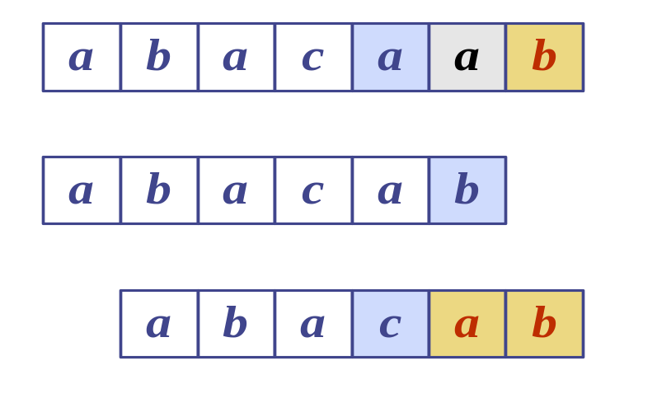
Pattern Matching
240-301, Computer Engineering Lab III (Software)
Semester 1, 2006-2007
Dr. Andrew Davison
WiG Lab (teachers room), CoE
ad@fivedots.coe.psu.ac.th
T:
Updated by:
Dr. Rinaldi Munir,
Informatika – STEI
Institut Teknologi Bandung
P:
Notes:
Pattern Matching

Slide 2
Overview
1. What is Pattern Matching?
2. The Brute Force Algorithm
3. The Knuth-Morris-Pratt Algorithm
4. The Boyer-Moore Algorithm
5. More Information

Slide 3
1. What is Pattern Matching?
Definisi: Diberikan:
T: teks (text), yaitu (long) string yang panjangnya n karakter
P: pattern, yaitu string dengan panjang m karakter (asumsi m <<< n) yang akan dicari di dalam teks.
Carilah (find atau locate) lokasi pertama di dalam teks yang bersesuaian dengan pattern.
Contoh:
    T: “the rain in spain stays mainly on the plain”
    P: “main”

Slide 4
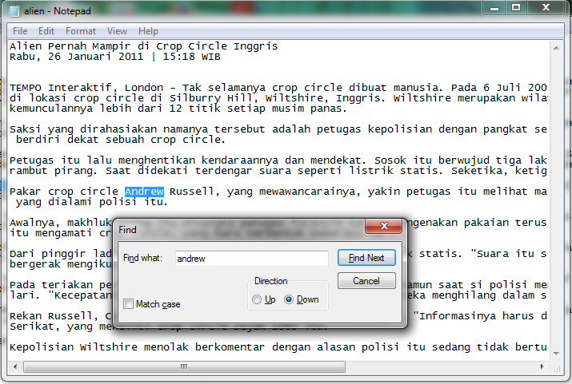
Aplikasi:
1. Pencarian di dalam Editor Text

Slide 5
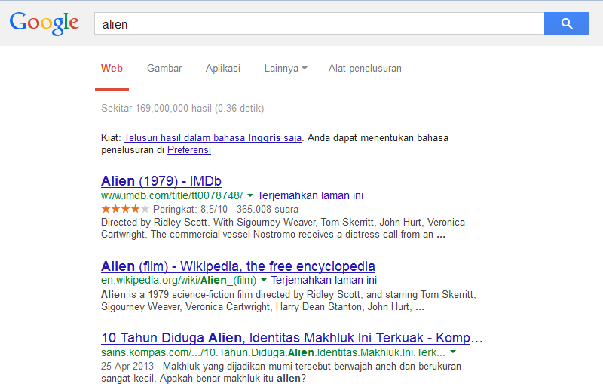
2. Web search engine (Misal: Google)

Slide 6
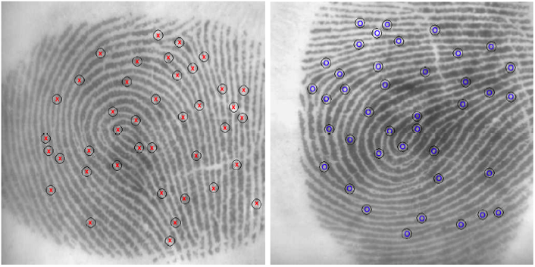
3. Analisis Citra

Slide 7
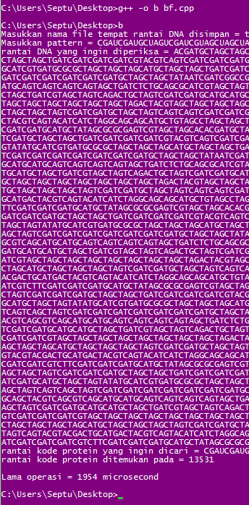
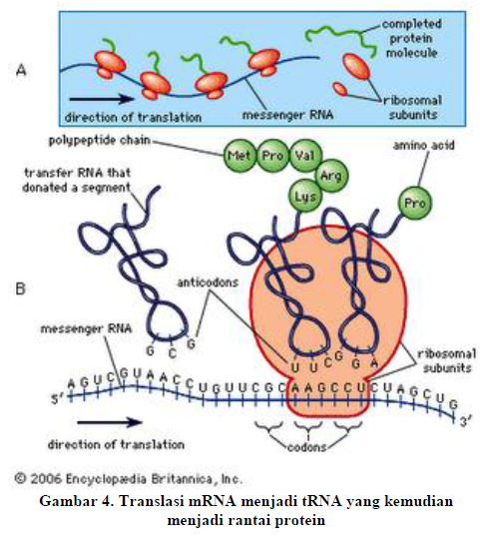
4. Bionformatics
Pencocokan Rantai Asam Amino
pada Rantai DNA
Sumber: Septu Jamasoka, IF2009

Slide 8
String Concepts
Assume S is a string of size m.
S = x₁x₂ … x_{m}
A prefix of S is a substring S[1 .. k-1]
A suffix of S is a substring S[k-1 .. m]
  k is any index between 1 and m
  S[0] is null character, the symbol is ∅

Slide 9
Examples
S
a
n
d
r
e
w
0
5
All possible prefixes of S:
  “∅”, “a", "an", "and", "andr”, "andre“,
All possible suffixes of S:
  “∅”, “w", “ew", “rew", “drew", “ndrew”

Slide 10
2. The Brute Force Algorithm
Check each position in the text T to see if the pattern P starts in that position
T:
a
n
d
r
e
w
T:
a
n
d
r
e
w
P:
r
e
w
P:
r
e
w
P moves 1 char at a time through T
. . . .

Slide 11
Pattern: NOT
Teks: NOBODY NOTICED HIM
NOBODY NOTICED HIM
1 NOT
2 NOT
3 NOT
4 NOT
5 NOT
6 NOT
7 NOT
8 NOT

Slide 12
Brute Force in Java
Return index where
pattern starts, or -1
public static int brute(String text,String pattern)
{ int n = text.length(); // n is length of text
int m = pattern.length(); // m is length of pattern
int j;
for(int i=0; i <= (n-m); i++) {
j = 0;
while ((j < m) && (text.charAt(i+j)== pattern.charAt(j)) ) {
j++;
}
if (j == m)
return i; // match at i
}
return -1; // no match
} // end of brute()

Slide 13
Usage
public static void main(String args[])
{ if (args.length != 2) {
System.out.println("Usage: java BruteSearch
<text> <pattern>");
System.exit(0);
}
System.out.println("Text: " + args[0]);
System.out.println("Pattern: " + args[1]);
int posn = brute(args[0], args[1]);
if (posn == -1)
System.out.println("Pattern not found");
else
System.out.println("Pattern starts at posn "
+ posn);
}

Slide 14
Analysis
Worst Case.
Jumlah perbandingan: m(n – m + 1) = O(mn)
Contoh:
  T: "aaaaaaaaaaaaaaaaaaaaaaaaaah"
  P: "aaah"
continued

Slide 15
Best case
Kompleksitas kasus terbaik adalah O(n).
Terjadi bila karakter pertama pattern P tidak pernah sama dengan karakter teks T yang dicocokkan
Jumlah perbandingan maksimal n kali:
Contoh:
T: String ini berakhir dengan zzz
P: zzz

Slide 16
Average Case
But most searches of ordinary text take
O(m+n), which is very quick.
Example of a more average case:
  T: "a string searching example is standard"
  P: "store"

Slide 17
The brute force algorithm is fast when the alphabet of the text is large
  e.g. A..Z, a..z, 1..9, etc.
It is slower when the alphabet is small
  e.g. 0, 1 (as in binary files, image files, etc.)
continued

Slide 18
2. The KMP Algorithm
The Knuth-Morris-Pratt (KMP) algorithm looks for the pattern in the text in a left-to-right order (like the brute force algorithm).
But it shifts the pattern more intelligently than the brute force algorithm.
continued

Slide 19

Donald E. Knuth
Donald Ervin Knuth (born January 10, 1938) is a computer scientist and Professor Emeritus at Stanford University. He is the author of the seminal multi-volume work The Art of Computer Programming.^{[3]} Knuth has been called the "father" of the analysis of algorithms. He contributed to the development of the rigorous analysis of the computational complexity of algorithms and systematized formal mathematical techniques for it. In the process he also popularized the asymptotic notation.

Slide 20
If a mismatch occurs between the text and pattern P at P[j], what is the most we can shift the pattern to avoid wasteful comparisons?
Answer: the largest prefix of P[1 .. j-1] that is a suffix of P[1 .. j-1]

Slide 21
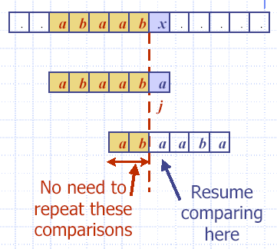
Example
i
T:
P:
j = 6
j_{new} = 3

Slide 22
Why
Find largest prefix (start) of:
“abaab" ( P[1..j-1] )
→ panjang = 5
which is suffix (end) of:
“abaab" ( P[1 .. j-1] )
Answer: “ab" → panjang = 2
Set j = 3 // the new j value
Jumlah pergeseran: s = 5 – 2 = 3

Slide 23
b
a
c
b
a
b
a
b
a
a
b
c
b
a
T
s
a
b
a
b
a
c
a
P
q
b
a
c
b
a
b
a
b
a
a
b
c
b
a
T
s’
a
b
a
b
a
c
a
P
k
a
b
a
b
a
P_{q}
Longest prefix of P_{q} that is also a suffix of P₅ is ‘aba’; so b[5]= 3
a
b
a
P_{k}
7-<number>

Slide 24
Fungsi Pinggiran KMP
(KMP Border Function)
KMP preprocesses the pattern to find matches of prefixes of the pattern with the pattern itself.
j = mismatch position in P[]
k = position before the mismatch (k = j-1).
The border function b(k) is defined as the size of the largest prefix of P[1..k] that is also a suffix of P[1..k].
The other name: failure function (disingkat: fail)

Slide 25
Border Function Example
P: "abaaba"
j: 123456
In code, b() is represented by an array, like the table.
j | 1 | 2 | 3 | 4 | 5 | 6
P[j] | a | b | a | a | b | a
b(j) | 0 | 0 | 1 | 1 | 2 | 3
b(j) is the size of
the largest border.

Slide 26
Why is b(5) == 2?
P: "abaaba"
b(5) means
  find the size of the largest prefix of P[1..5] that is also a suffix of P[1..5]
  find the size largest prefix of "abaab" that
  is also a suffix of "baab“
  find the size of "ab"
  = 2

Slide 27
Contoh lain: P = ababababca
J | 1 | 2 | 3 | 4 | 5 | 6 | 7 | 8 | 9 | 10
P [j] | a | b | a | b | a | b | a | b | c | a
b[j] | 0 | 0 | 1 | 2 | 3 | 4 | 5 | 6 | 0 | 1

Slide 28
Using the Border Function
Knuth-Morris-Pratt’s algorithm modifies the brute-force algorithm.
  if a mismatch occurs at P[j]
  (i.e. P[j] != T[i]), then
  k = j-1;
  j = b(k) + 1; // obtain the new j

Slide 29
KMP in Java
Return index where
pattern starts, or -1
public static int kmpMatch(String text,
String pattern)
{
int n = text.length();
int m = pattern.length();
int fail[] = computeFail(pattern);
int i=0;
int j=0;
:

Slide 30
while (i < n) {
if (pattern.charAt(j) == text.charAt(i)) {
if (j == m - 1)
return i - m + 1; // match
i++;
j++;
}
else if (j > 0)
j = fail[j-1];
else
i++;
}
return -1; // no match
} // end of kmpMatch()

Slide 31
public static int[] computeFail(
String pattern)
{
int fail[] = new int[pattern.length()];
fail[0] = 0;
int m = pattern.length();
int j = 0;
int i = 1;
:

Slide 32
while (i < m) {
if (pattern.charAt(j) ==
pattern.charAt(i)) { //j+1 chars match
fail[i] = j + 1;
i++;
j++;
}
else if (j > 0) // j follows matching prefix
j = fail[j-11];
else { // no match
fail[i] = 0;
i++;
}
}
return fail;
} // end of computeFail()
Similar code
to kmpMatch()

Slide 33
Usage
public static void main(String args[])
{ if (args.length != 2) {
System.out.println("Usage: java KmpSearch
<text> <pattern>");
System.exit(0);
}
System.out.println("Text: " + args[0]);
System.out.println("Pattern: " + args[1]);
int posn = kmpMatch(args[0], args[1]);
if (posn == -1)
System.out.println("Pattern not found");
else
System.out.println("Pattern starts at posn "
+ posn);
}

Slide 34
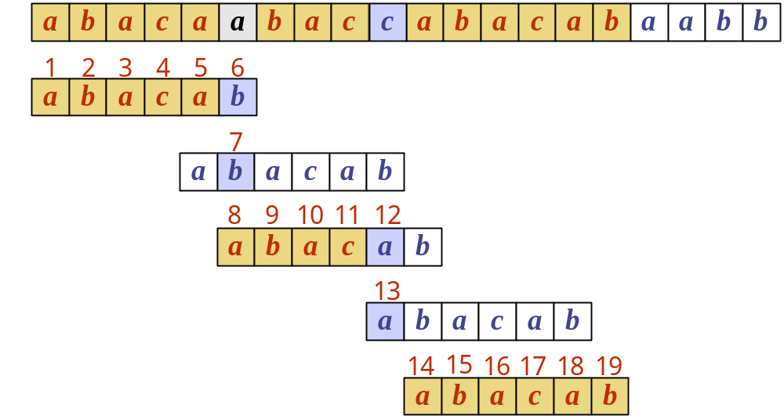
Example
T:
P:
k
1
2
3
4
5
6
b(k)
0
0
1
0
1
0

Slide 35
Why is b(5) == 1?
P: "abacab"
b(5) means
  find the size of the largest prefix of P[1..5] that is also a suffix of P[1..5]
  = find the size largest prefix of "abaca" that
  is also a suffix of "baca"
  = find the size of "a"
  = 1

Slide 36
Kompleksitas Waktu KMP
Menghitung fungsi pinggiran : O(m),
Pencarian string : O(n)
Kompleksitas waktu algoritma KMP adalah O(m+n).
- sangat cepat dibandingkan brute force

Slide 37
KMP Advantages
The algorithm never needs to move backwards in the input text, T
  this makes the algorithm good for processing very large files that are read in from external devices or through a network stream

Slide 38
KMP Disadvantages
KMP doesn’t work so well as the size of the alphabet increases
  more chance of a mismatch (more possible mismatches)
  mismatches tend to occur early in the pattern, but KMP is faster when the mismatches occur later

Slide 39
KMP Extensions
The basic algorithm doesn't take into account the letter in the text that caused the mismatch.
T:
a
b
a
a
b
x
Basic KMP
does not do this.
P:
a
b
a
a
b
a
a
b
a
a
b
a

Slide 40
Latihan
Diberikan sebuah text: abacaabaccabacabaa dan pattern: abacab.
Hitung fungsi pinggiran
Gambarkan proses pencocokan string dengan algoritma KMP sampai pattern ditemukan
Berapa jumlah perbandingan karakter yang terjadi?

Slide 41
3. The Boyer-Moore Algorithm
The Boyer-Moore pattern matching algorithm is based on two techniques.
1. The looking-glass technique
  find P in T by moving backwards through P, starting at its end

Slide 42
2. The character-jump technique
  when a mismatch occurs at T[i] == x
  the character in pattern P[j] is not the
  same as T[i]
There are 3 possible
cases, tried in order.
T
x
a
i
P
b
a
j

Slide 43
Case 1
If P contains x somewhere, then try to
shift P right to align the last occurrence
of x in P with T[i].
T
T
?
x
a
x
a
?
i
i_{new}
and
move i and
j right, so
j at end
P
P
x
c
b
a
x
c
b
a
j
j_{new}

Slide 44
Case 2
If P contains x somewhere, but a shift right to the last occurrence is not possible, then
shift P right by 1 character to T[i+1].
T
T
?
x
a
x
x
a
x
i
i_{new}
and
move i and
j right, so
j at end
P
P
c
w
a
x
c
w
a
x
j
x is after
j position
j_{new}

Slide 45
Case 3
If cases 1 and 2 do not apply, then shift P to align P[1] with T[i+1].
T
T
x
a
x
a
?
?
?
i
i_{new}
and
move i and
j right, so
j at end
P
P
d
c
b
a
d
c
b
a
j
1
j_{new}
No x in P

Slide 46
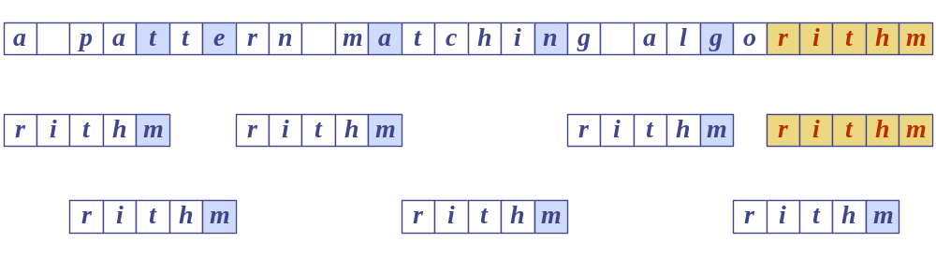
Boyer-Moore Example (1)
T:
P:

Slide 47
Last Occurrence Function
Boyer-Moore’s algorithm preprocesses the pattern P and the alphabet A to build a last occurrence function L()
  L() maps all the letters in A to integers
L(x) is defined as: // x is a letter in A
  the largest index i such that P[i] == x, or
  -1 if no such index exists

Slide 48
L() Example
P
a
b
a
c
a
b
1
2
3
4
5
6
A = {a, b, c, d}
P: "abacab"
x
a
b
c
d
L(x)
5
6
4
-1
L() stores indexes into P[]

Slide 49
Note
In Boyer-Moore code, L() is calculated when the pattern P is read in.
Usually L() is stored as an array
  something like the table in the previous slide

Slide 50
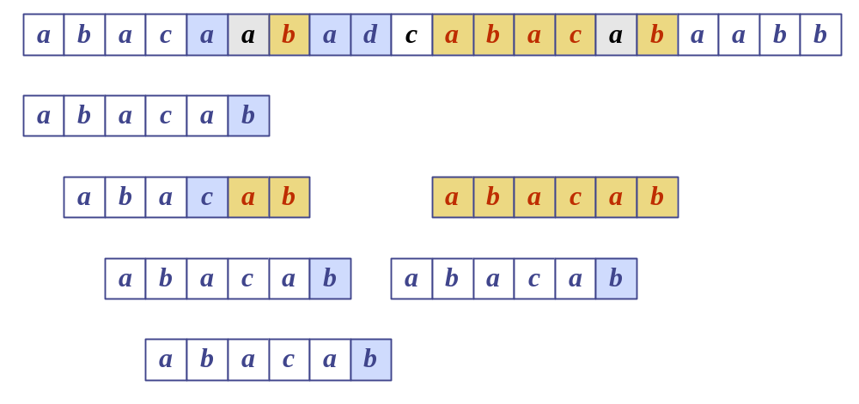
Boyer-Moore Example (2)
T:
P:
x
a
b
c
d
L(x)
5
6
4
−1

Slide 51
Boyer-Moore in Java
Return index where
pattern starts, or -1
public static int bmMatch(String text,
String pattern)
{
int last[] = buildLast(pattern);
int n = text.length();
int m = pattern.length();
int i = m-1;
if (i > n-1)
return -1; // no match if pattern is
// longer than text
:

Slide 52
int j = m-1;
do {
if (pattern.charAt(j) == text.charAt(i))
if (j == 0)
return i; // match
else { // looking-glass technique
i--;
j--;
}
else { // character jump technique
int lo = last[text.charAt(i)]; //last occ
i = i + m - Math.min(j, 1+lo);
j = m - 1;
}
} while (i <= n-1);
return -1; // no match
} // end of bmMatch()

Slide 53
public static int[] buildLast(String pattern)
/* Return array storing index of last
occurrence of each ASCII char in pattern. */
{
int last[] = new int[128]; // ASCII char set
for(int i=0; i < 128; i++)
last[i] = -1; // initialize array
for (int i = 0; i < pattern.length(); i++)
last[pattern.charAt(i)] = i;
return last;
} // end of buildLast()

Slide 54
Usage
public static void main(String args[])
{ if (args.length != 2) {
System.out.println("Usage: java BmSearch
<text> <pattern>");
System.exit(0);
}
System.out.println("Text: " + args[0]);
System.out.println("Pattern: " + args[1]);
int posn = bmMatch(args[0], args[1]);
if (posn == -1)
System.out.println("Pattern not found");
else
System.out.println("Pattern starts at posn "
+ posn);
}

Slide 55
Analysis
Boyer-Moore worst case running time is
O(nm + A)
But, Boyer-Moore is fast when the alphabet (A) is large, slow when the alphabet is small.
  e.g. good for English text, poor for binary
Boyer-Moore is significantly faster than brute force for searching English text.

Slide 56
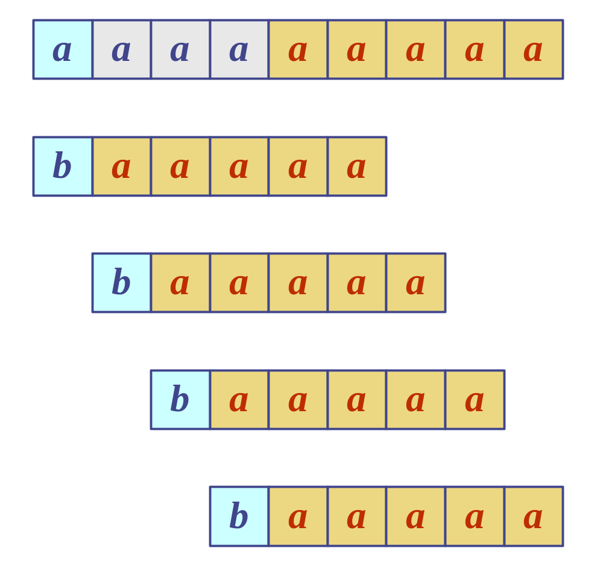
Worst Case Example
T:
T: "aaaaa…a"
P: "baaaaa"
P:

Slide 57
5. More Information
This book is
in the CoE library.
Algorithms in C++
Robert Sedgewick
Addison-Wesley, 1992
  chapter 19, String Searching
Online Animated Algorithms:
  http://www.ics.uci.edu/~goodrich/dsa/
  11strings/demos/pattern/
  http://www-sr.informatik.uni-tuebingen.de/
  ~buehler/BM/BM1.html
  http://www-igm.univ-mlv.fr/~lecroq/string/

